Slide 1
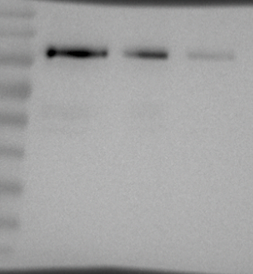
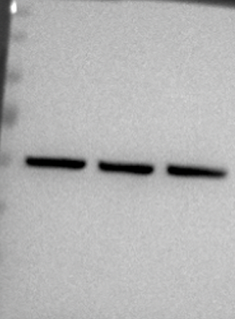
Figure 6C. Bmm protein when manipulating CSN-CG2064
Bmm-GFP,
ppl>DGAT1
Bmm-GFP,
ppl>DGAT1,
CSN2 RNAi
Bmm-GFP,
ppl>DGAT1,
CG2064
anti-GFP
anti-tubulin

