Slide 1
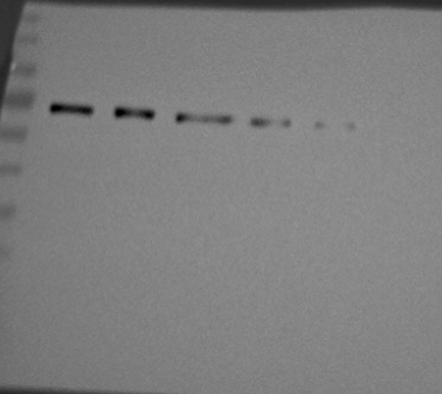
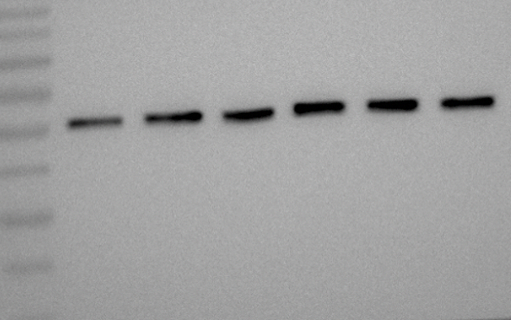
Figure 7A. CG2064 degradation in S2
actin>CG2064-GFP
CHX
0 h
0.5 h
1 h
2 h
4 h
6 h
anti-GFP
anti-tubulin

Slide 2
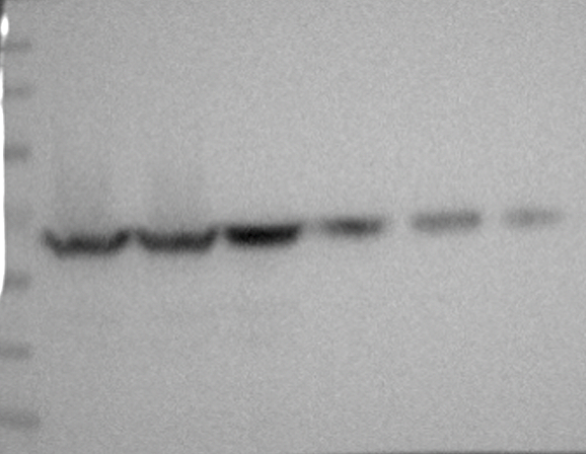
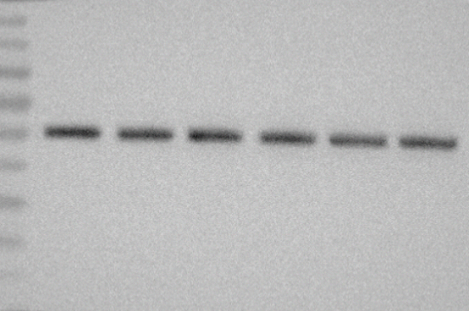
Figure 7A. CG2064 degradation in CSN RNAi in S2
actin>CG2064-GFP
CHX
0 h
0.5 h
1 h
2 h
4 h
6 h
+
+
+
+
+
+
dsDNA for CSN2 RNAi
anti-GFP
anti-tubulin

Slide 3
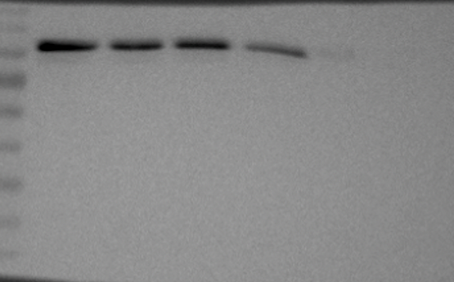
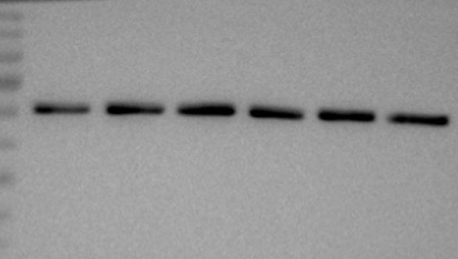
Figure 7C. Bmm degradation in S2
actin>Bmm-GFP
CHX
0 h
0.5 h
1 h
2 h
4 h
6 h
anti-GFP
anti-tubulin

Slide 4
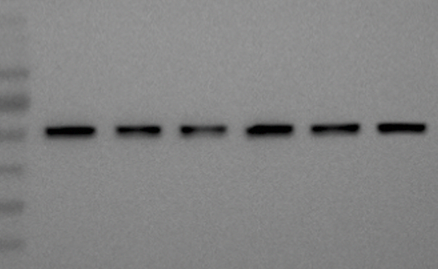
Figure 7C. Bmm degradation in CSN RNAi in S2
actin>Bmm-GFP
CHX
0 h
0.5 h
1 h
2 h
4 h
6 h
+
+
+
+
+
+
dsDNA for CSN2 RNAi
anti-GFP
anti-tubulin

Slide 5
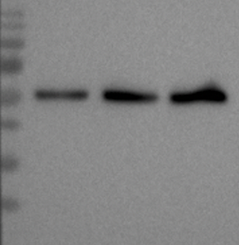
Figure 7E. CG2064 protein when manipulating CSN-CG2064
CG2064-GFP,
ppl-Gal4
CG2064-GFP,
ppl>CSN7 RNAi
CG2064-GFP,
ppl>CSN2 RNAi
anti-GFP
anti-tubulin

