Slide 1
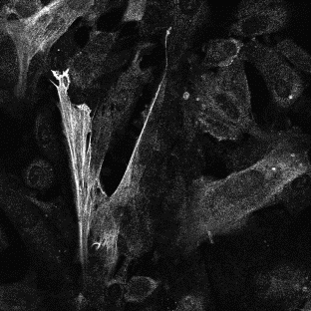
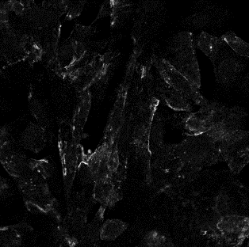
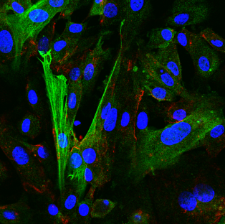
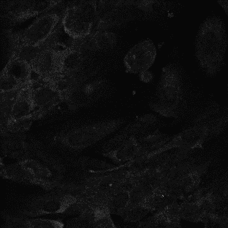
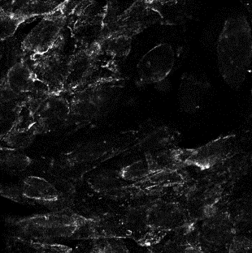
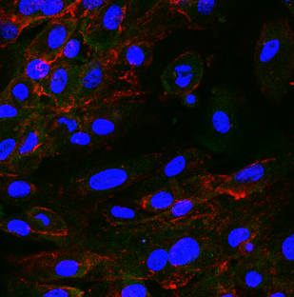
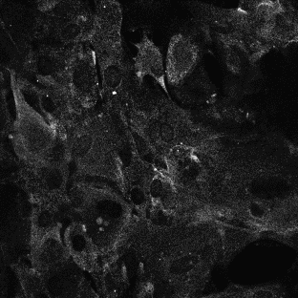
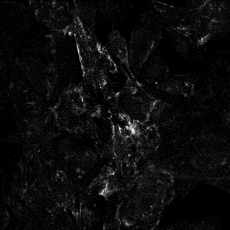
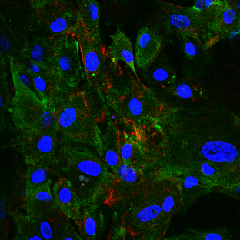
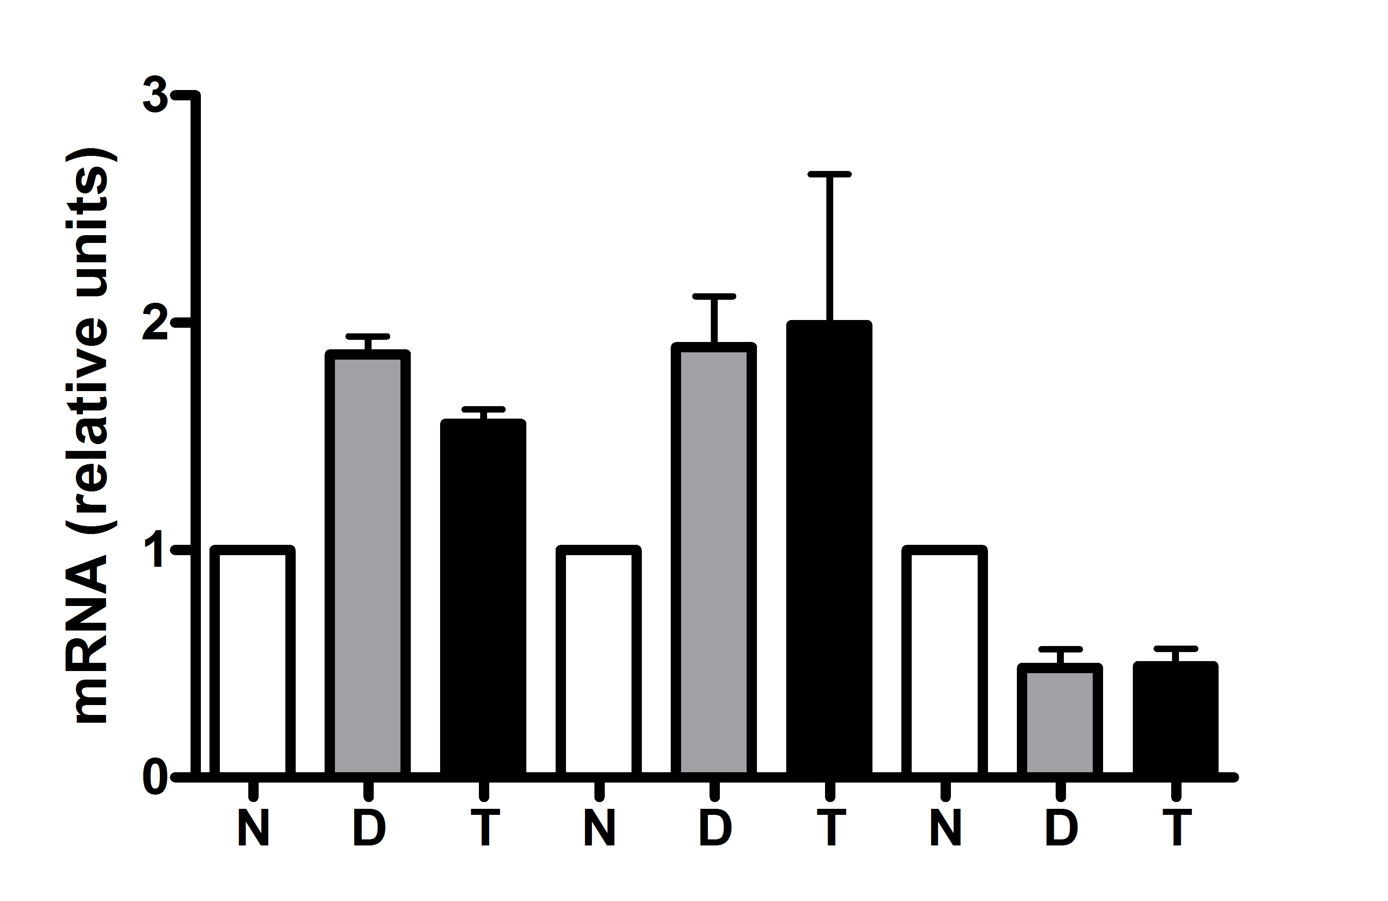


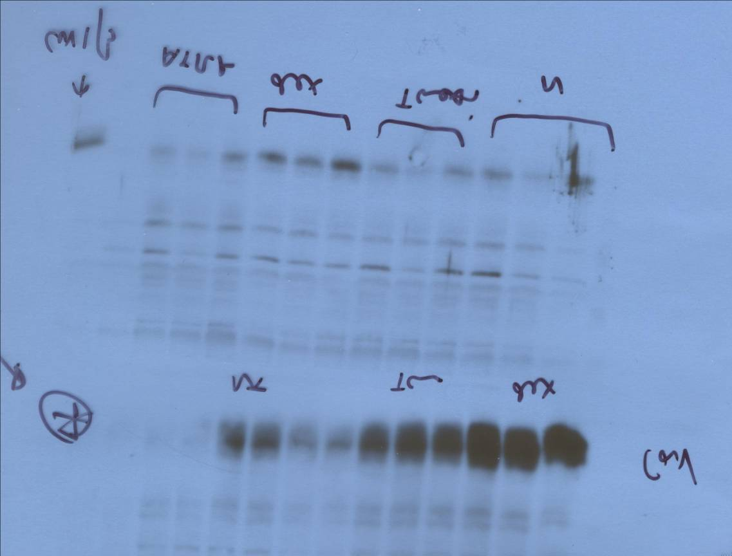
Supplementary figure 6
A
α−SMA
cav1
Merge
*
DMSO
DEXAMETHASONE
TAMOXIFEN
B
C
DEX
TAM
DMSO
64 .85 .80 .54 .38 .41 1 1
*
*
*
*
α-SMA
*
ERK1/2
*
*
*
.71 .91 .95 1.4 1.5 1.3 .54 .49
Cav1
Cav1
E-cad
Vim

