Slide 1
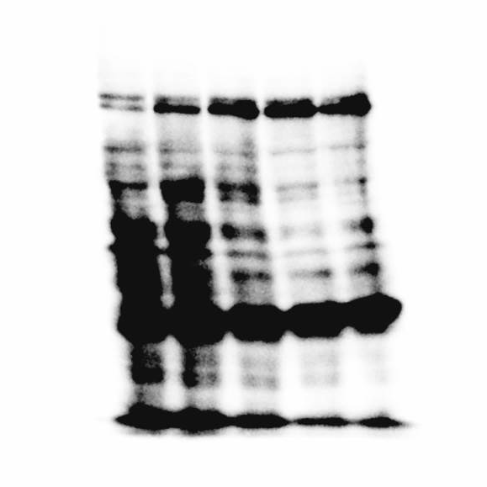
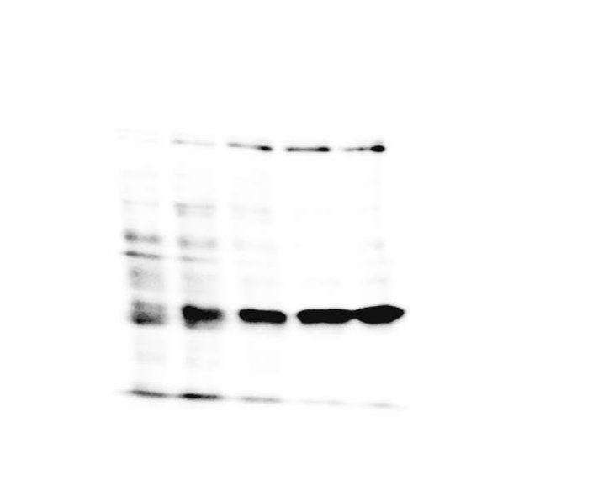
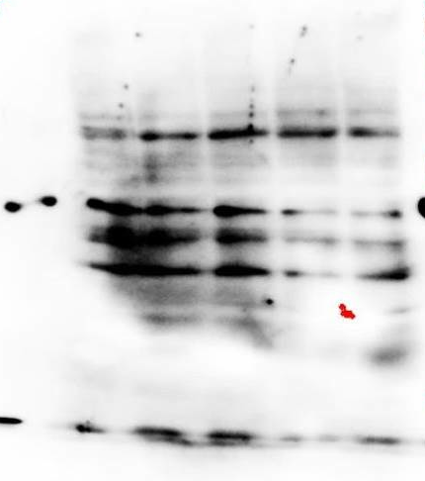
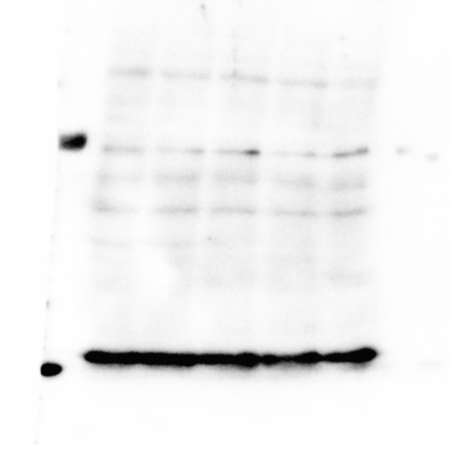
Figure 2F, upper panel
P-IRE1α
IRE1α
PSA
R1881:
-
+
+
+
+
R1881:
-
+
+
+
+
R1881:
-
+
+
+
+
kDa
24h
48h
72h
96h
kDa
24h
48h
72h
96h
24h
48h
72h
96h
100
100
75
kDa
75
50
37
GAPDH
R1881:
-
+
+
+
+
24h
48h
72h
96h
kDa
50
37

Slide 2
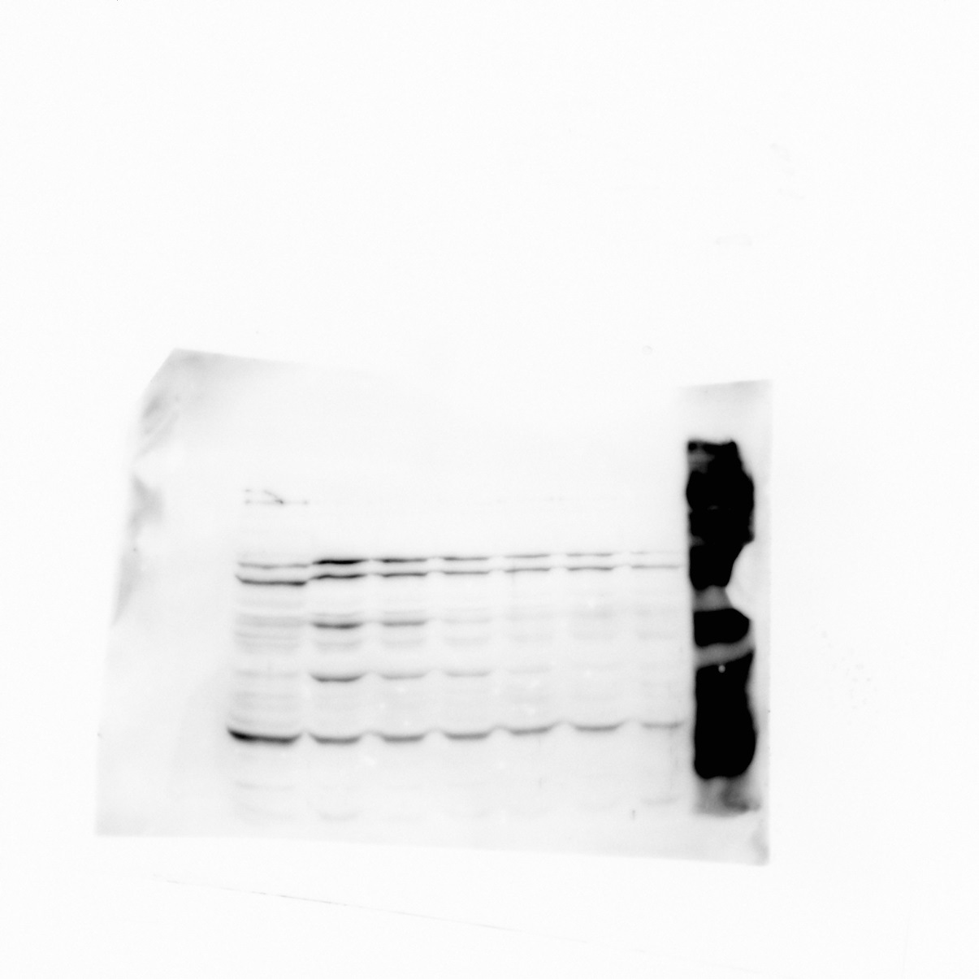
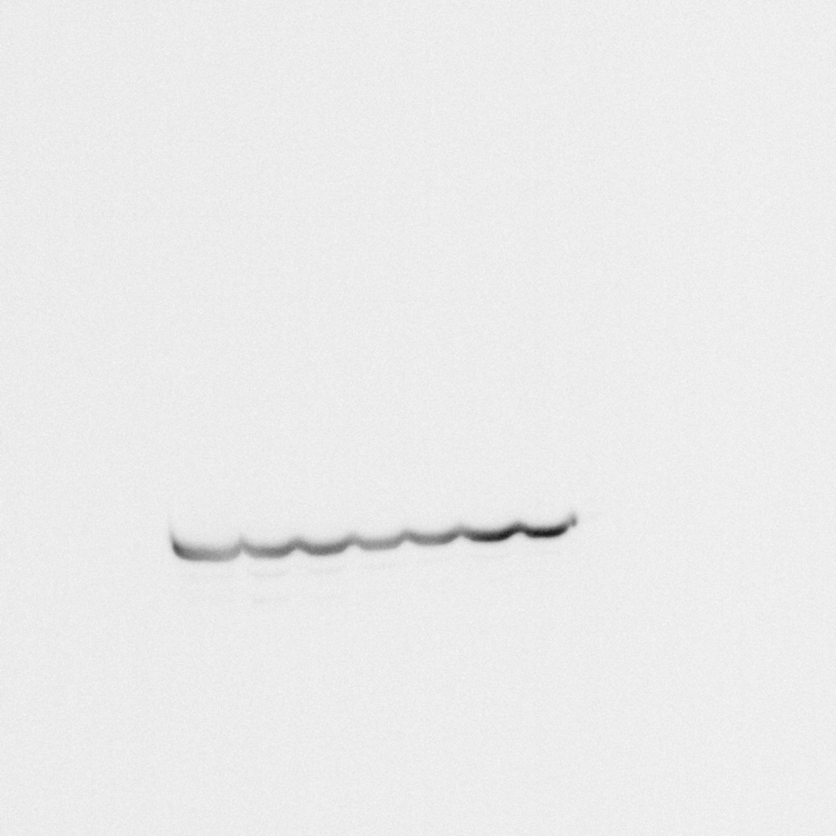
Figure 2F, lower panel
XBP-1
GAPDH
kDa
kDa
50
Spliced
50
37
37
Unspliced
25
R1881:
-
+
+
+
+
+
TG
6h
24h
36h
48h
72h
R1881:
-
+
+
+
+
+
TG
TG = Thapsigargin
6h
24h
36h
48h
72h

Slide 3
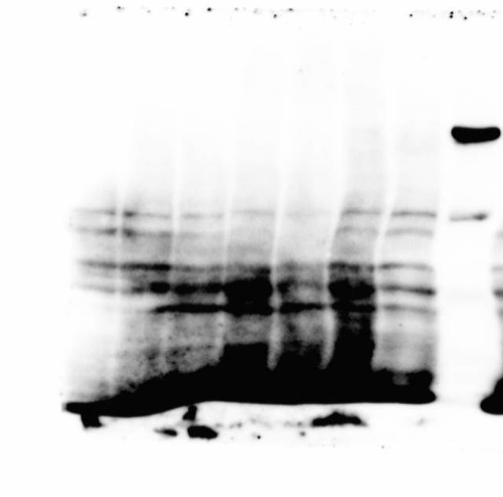
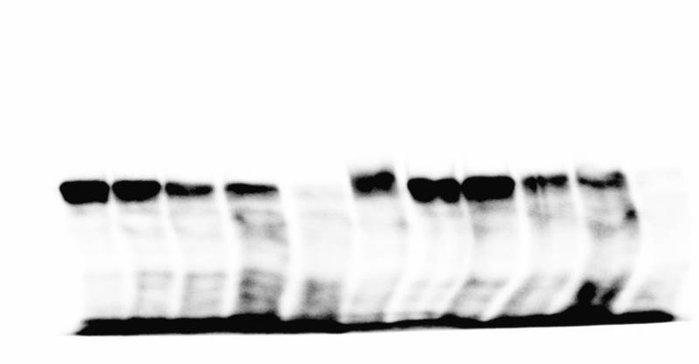
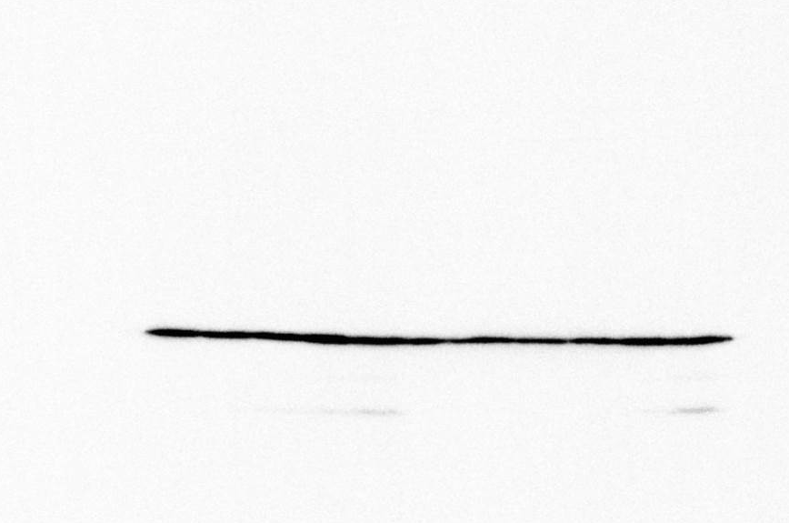
Figure 2G, upper panel, left
PERK
P-PERK
kDa
R1881:
-
+
+
+
+
TG
250
R1881:
-
+
+
+
+
TG
250
12h
24h
48h
72h
12h
24h
48h
72h
150
150
GAPDH
R1881:
-
+
+
+
+
TG
12h
24h
48h
72h
37

Slide 4
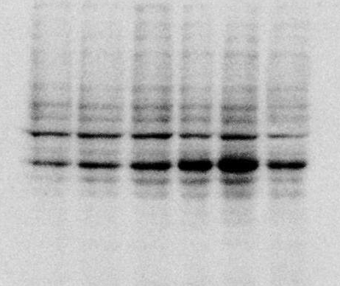
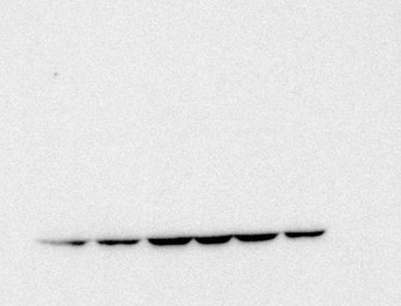
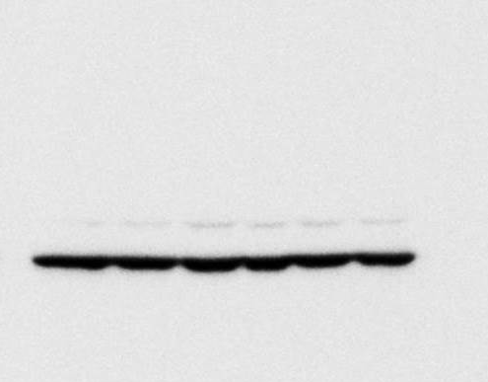
Figure 2G, upper panel, right
kDa
ATF4
kDa
CHOP
kDa
GAPDH
100
100
100
75
75
75
50
50
50
37
37
37
25
25
25
R1881:
-
+
+
+
+
+
R1881:
-
+
+
+
+
+
R1881:
-
+
+
+
+
+
12h
24h
48h
72h
96h
12h
24h
48h
72h
96h
12h
24h
48h
72h
96h

Slide 5
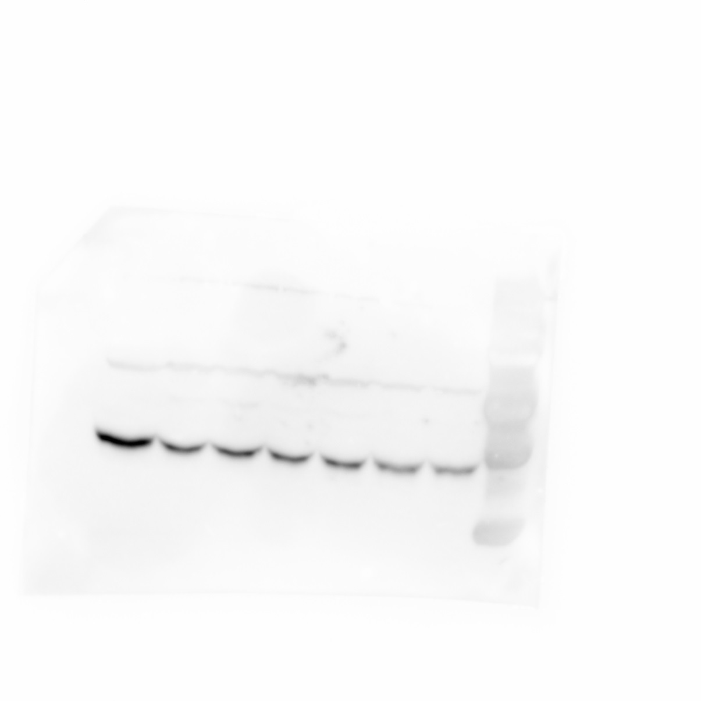
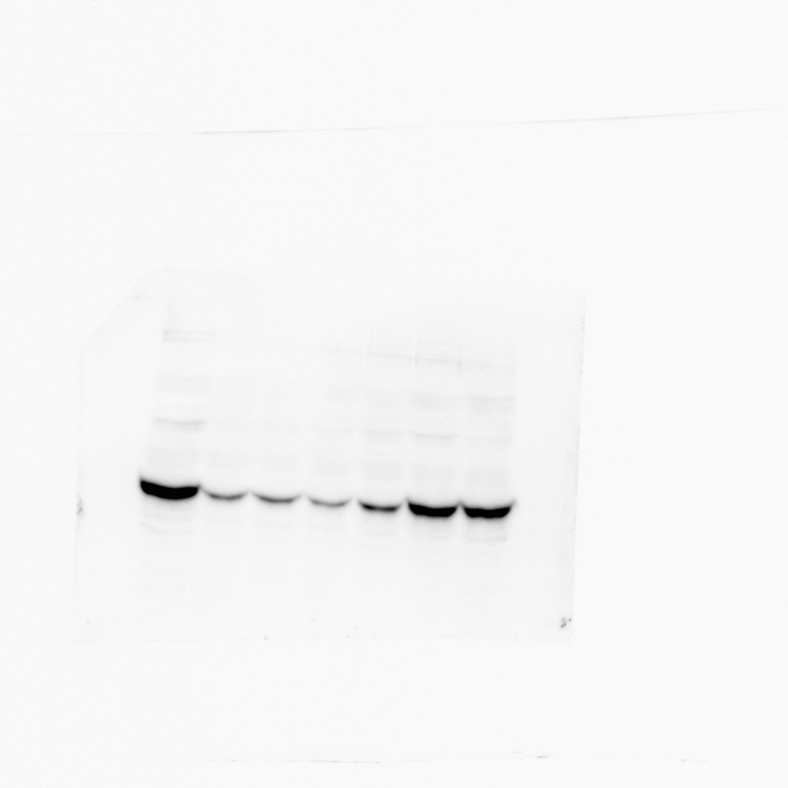
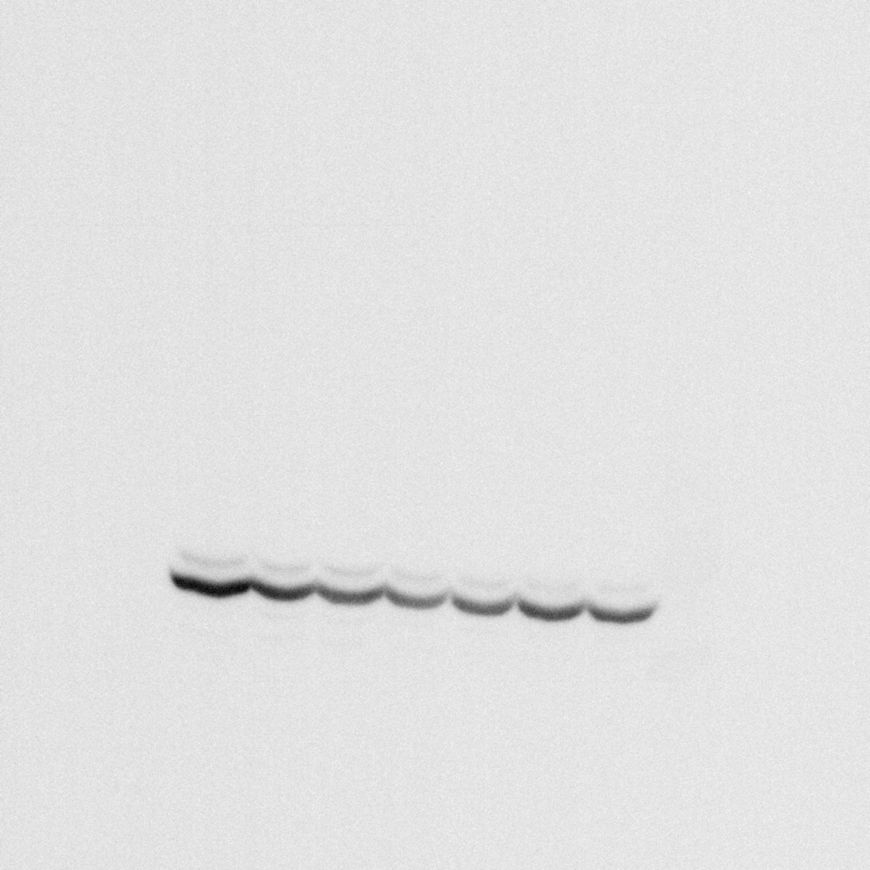
Figure 2G, lower panel
P-eIF2α
T-eIF2α
kDa
kDa
50
50
37
37
25
R1881:
-
+
+
+
+
+
TG
R1881:
-
+
+
+
+
+
TG
6h
24h
36h
48h
72h
6h
24h
36h
48h
72h
GAPDH
kDa
50
37
R1881:
-
+
+
+
+
+
TG
6h
24h
36h
48h
72h

