Slide 1
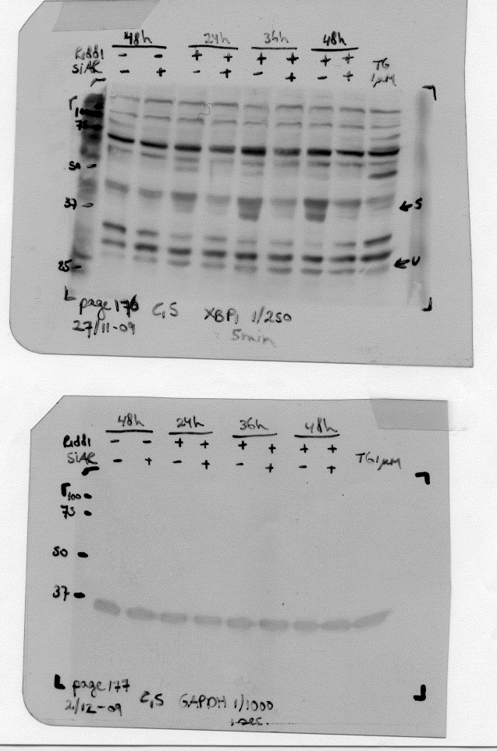
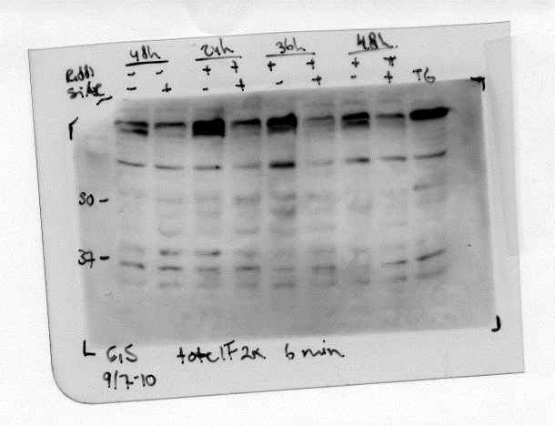
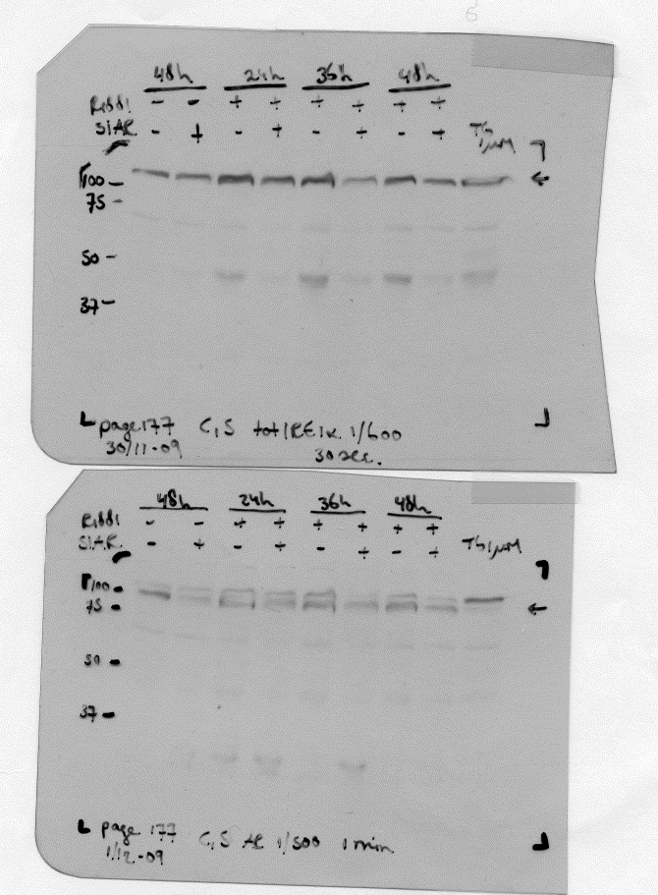
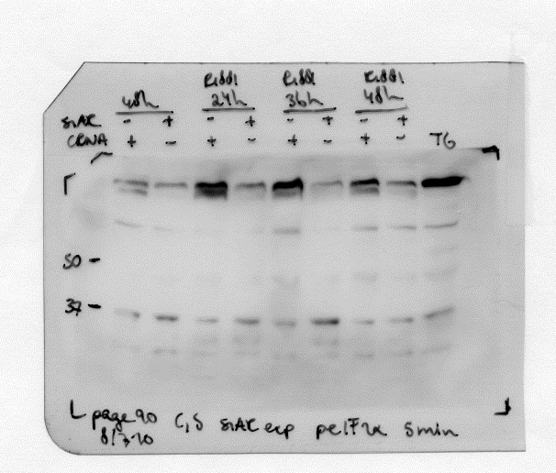
Figure 3F
Spliced
Unspliced
XBP-1
T-eIF2α
IRE1α
GAPDH
P-eIF2α
AR

