Slide 1
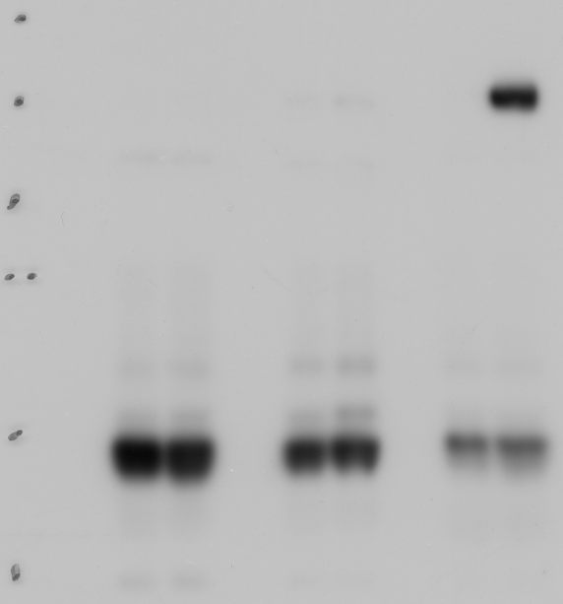
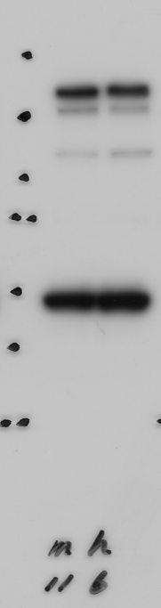
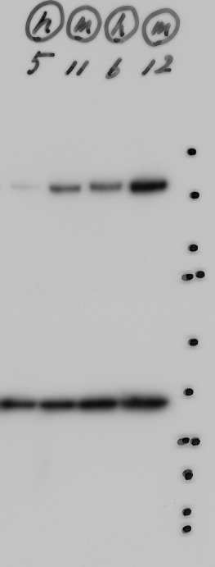
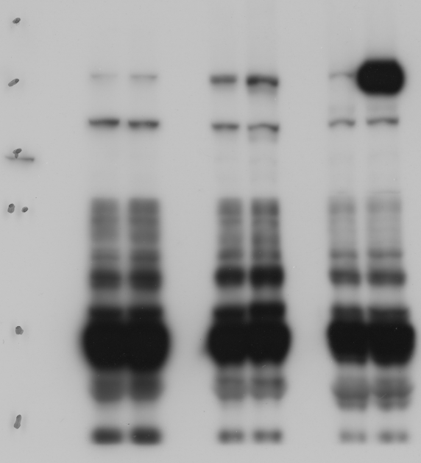
Full unedited gel for Figure 7C
ear
thymus
heart
kDa
TG
WT
WT
TG
TG
WT
250
α-Dia1/DIA1
kDa
150
250
kDa
100
α-Dia1/DIA1
150
75
100
250
75
α-GFP
150
50
50
100
α-tubulin
α-tubulin
75
37
50
37
25
α-GAPDH
37
10 sec exposure
25
250
20
15
150
α-Dia1/DIA1
100
HEK293 Cells
75
50
37
60 sec exposure

Slide 2
Full unedited gel for Figure 7B
WT
TG
WT
TG
WT
TG
WT
TG
kDa
250
150
100
75
Inner ear
Heart
Inner ear
Heart
αFLAG
Exposure time
10 min
15 sec

