Slide 1
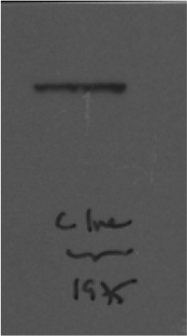
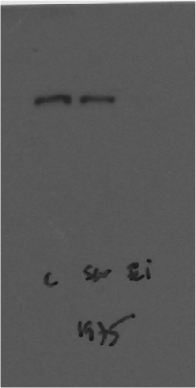
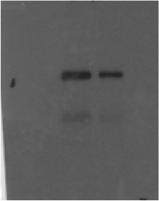
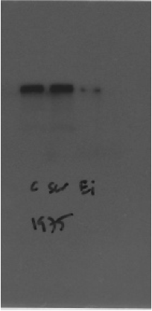
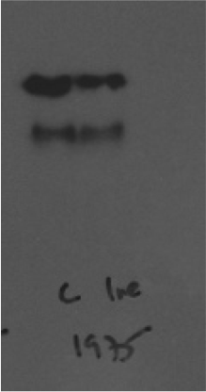
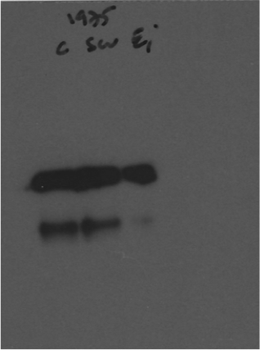
Source Data Fig 2D
H1975
EGFR (170kDa)
FASN (270kDa)
Control = vehicle
untreated
Control = vehicle
scrambled
untreated
EGFRi#1i
scrambled
Gefitinib
Gefitinib
EGFRi#1i
*
SREBP1
125kDa
68kDa
*
125kDa
68kDa
Gefitinib
untreated
EGFRi#1i
Control = vehicle
scrambled

