Slide 1
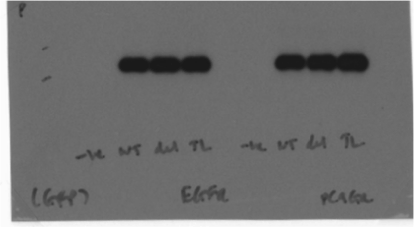
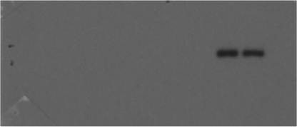
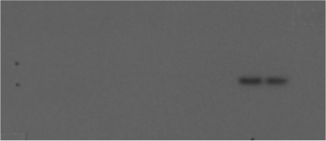
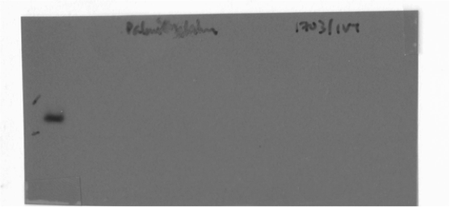
Source Data Fig 4C
EGFR L858R/T790M
EGFR L858R/T790M
EGFR del746-750
EGFR del746-750
EGFR wild-type
EGFR wild-type
No DNA
No DNA
197kDa
tGFP –
loading control
Palmitoylated
EGFR (PC-9GR)
197kDa
Palmitoylated
EGFR (H1975)
197kDa
197kDa
Palmitoylated
EGFR (H1703)
Positive
control
HAM-
HAM+

