Slide 1
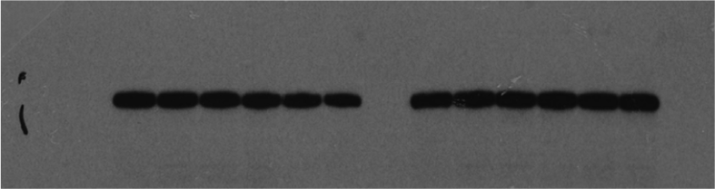
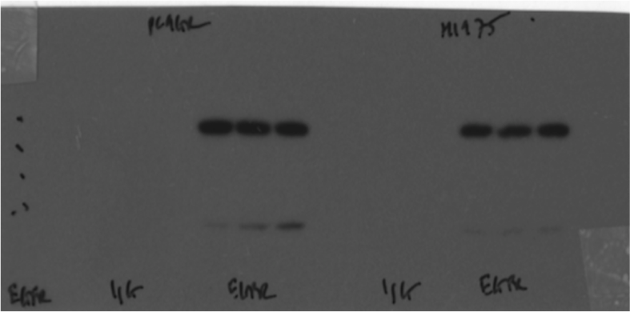
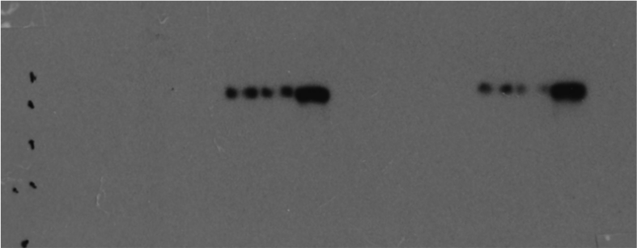
Source Data Fig 5E
Gefitinib
Gefitinib
Gefitinib
Gefitinib
vehicle
vehicle
vehicle
vehicle
Orlistat
Orlistat
Orlistat
Orlistat
Loading control
ACTB
43kDa
EGFR
170kDa
K48-linked
Ubiquitin
170kDa
PC-9GR
H1975
IgG
EGFR
IgG
EGFR
PC-9GR
H1975

