Slide 1
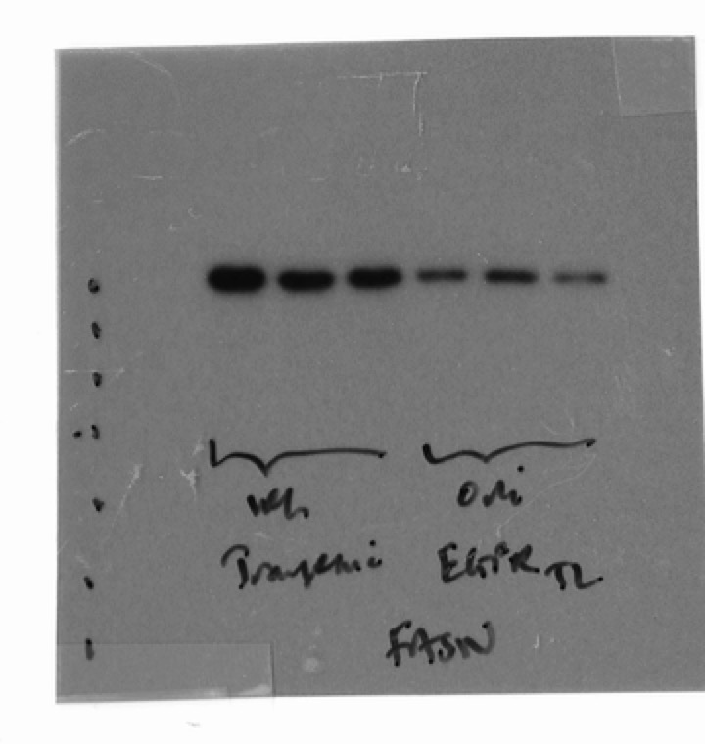
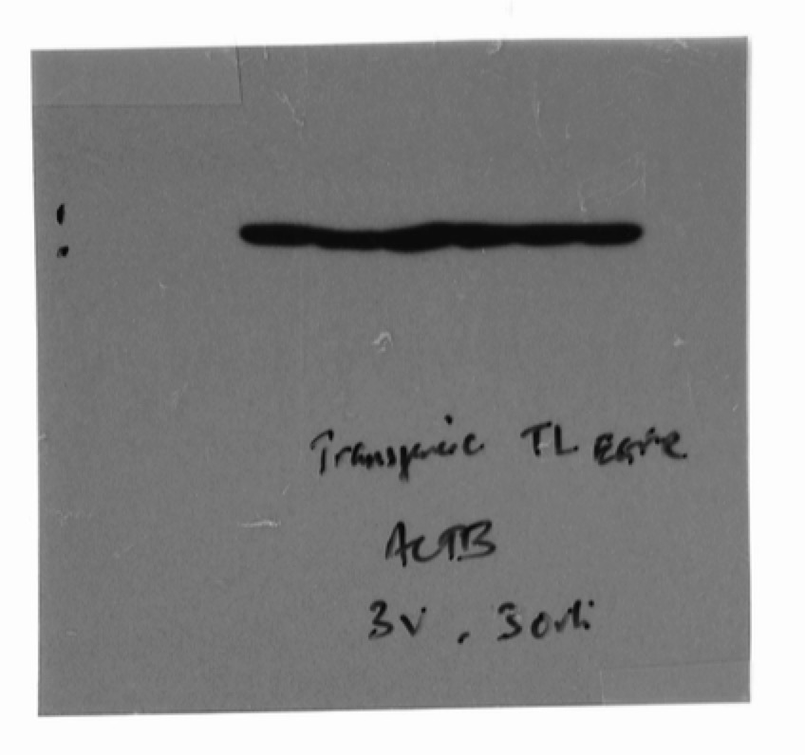
Source Data Fig 7D
vehicle
Orlistat
FASN, 270kDa
ACTB, 43kDa

