Slide 1
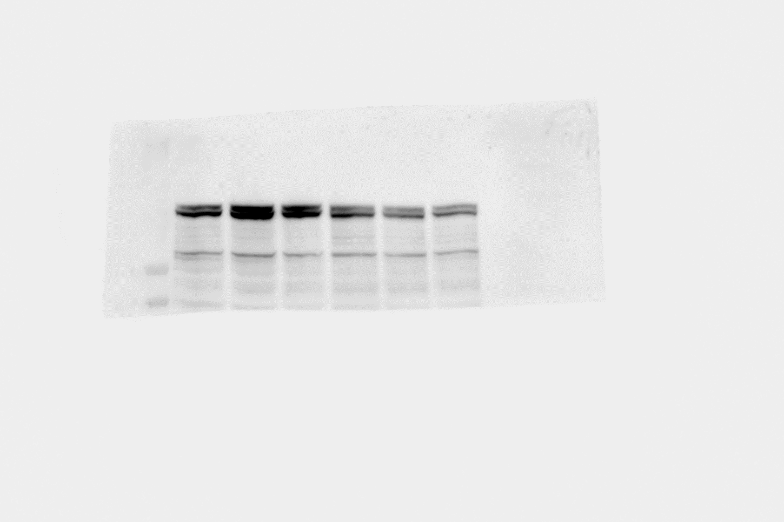
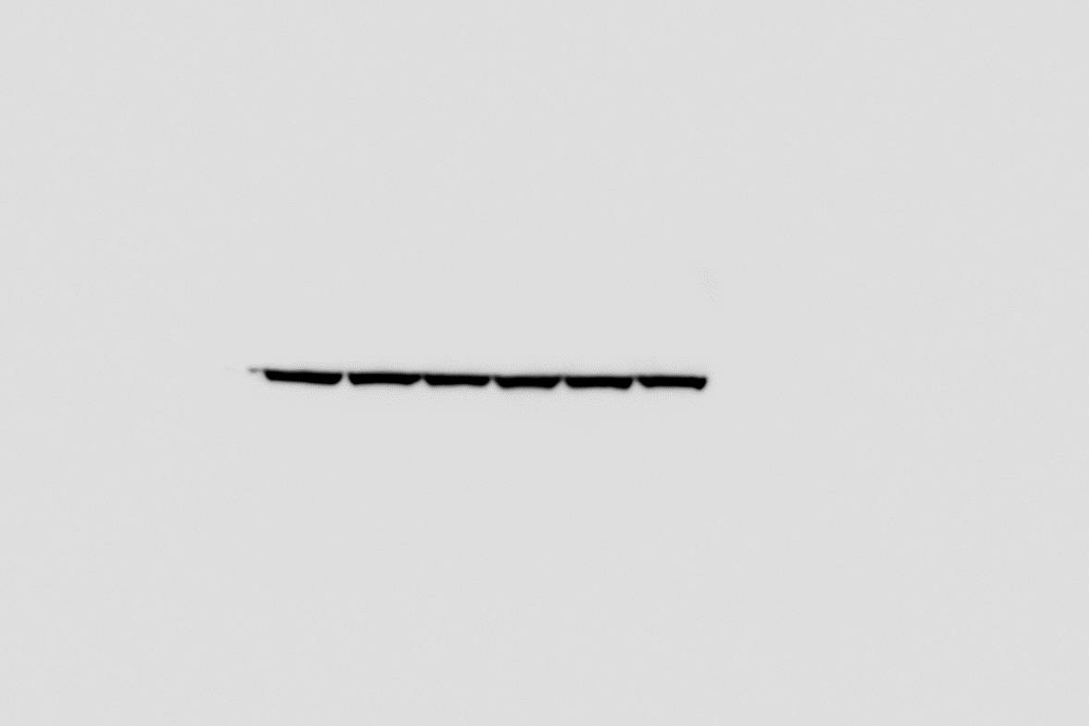
Uncropped blots Figure 2B
260
160
ASK1
110
50
40
Actin
30

Slide 2
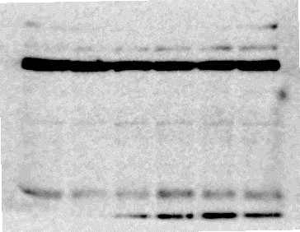
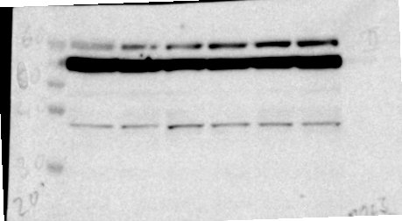
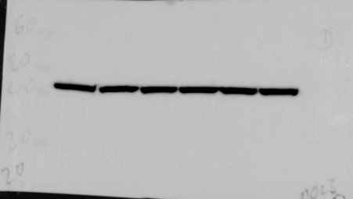
Uncropped blots Figure 2D
60
50
40
30
20
LC3-II
60
p62
50
40
30
20
60
50
40
Actin
30
20

