Slide 1
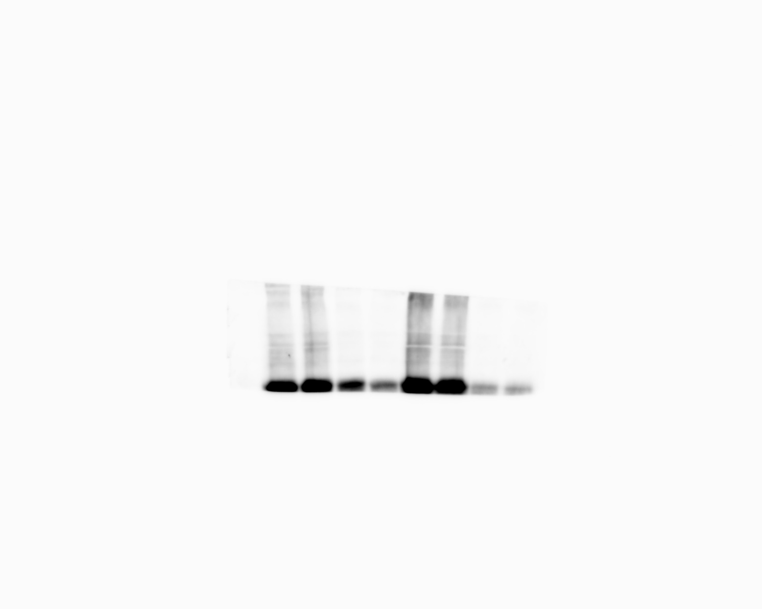
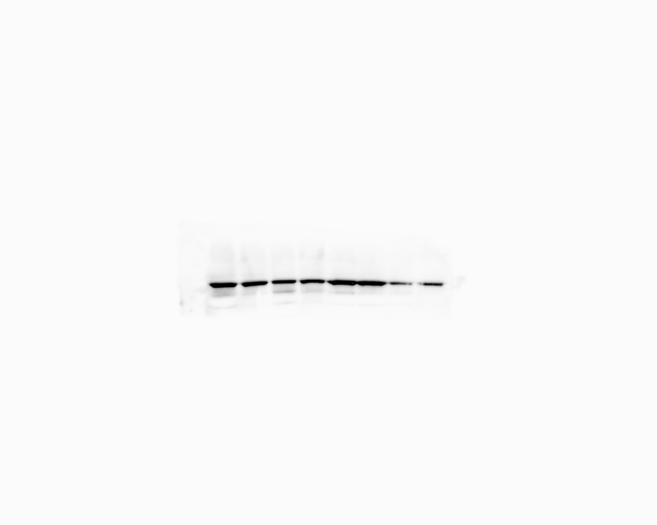
Uncropped blots Figure 3I
70
COL1A1
100
HSP90

