Slide 1
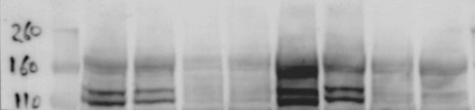
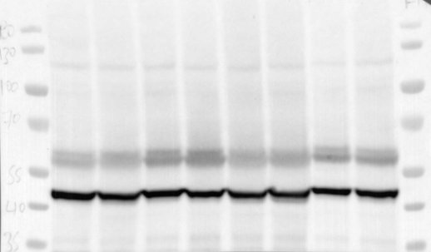
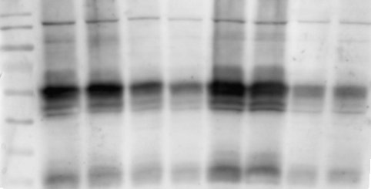
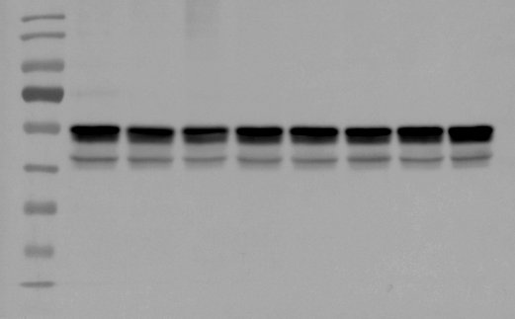
Uncropped blots Figure 4A
ASK1
180
130
100
70
55
Actin
40
35
180
130
100
70
55
pJNK
40
35
180
130
100
70
55
JNK
40
35
25
15

Slide 2
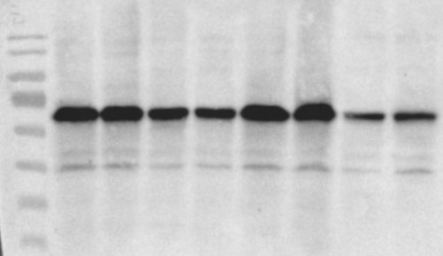
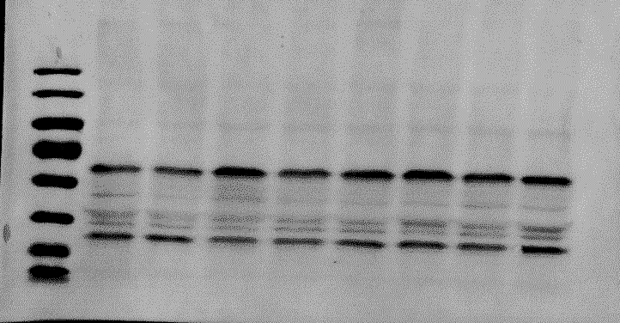
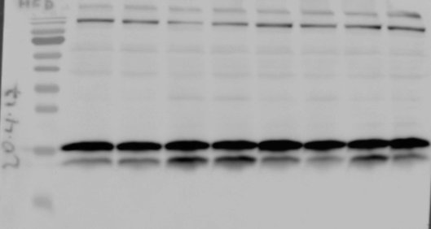
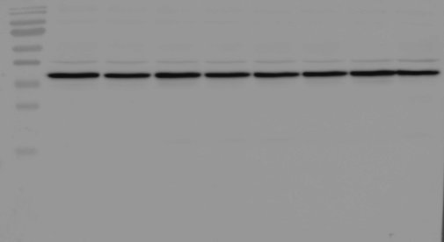
Uncropped blots Figure 4A
180
130
100
70
P-BCN1
55
40
35
25
180
130
100
70
55
BCN1
40
35
25
70
40
35
25
15
LC3
10
70
40
GAPDH
35
25
10

Slide 3
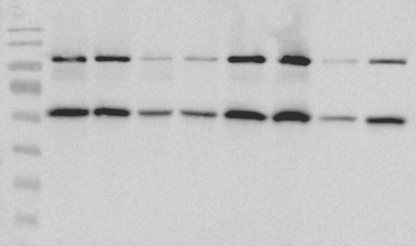
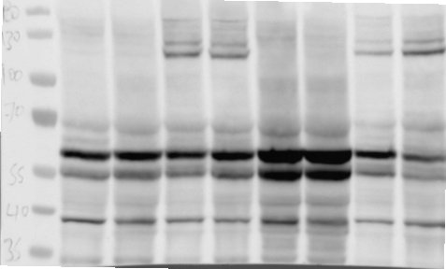
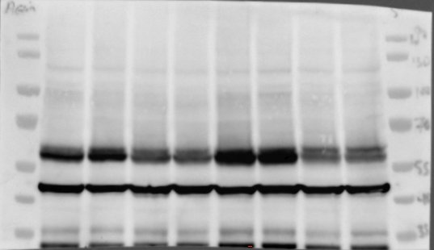
Uncropped blots Figure 4A
180
130
100
70
55
ATG12
40
35
25
180
130
100
70
p62
55
40
35
180
130
100
70
55
Actin
40
35

