Slide 1
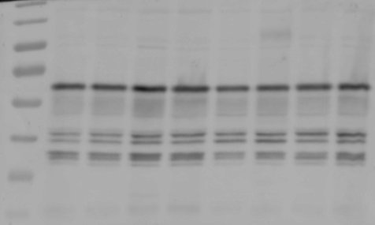
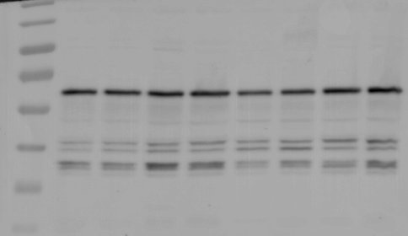
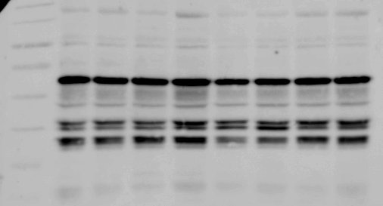
Uncropped blots for Figure 7C
70
55
pJNK
40
35
130
100
70
55
JNK
40
35
180
130
100
70
p-BCN1
55
40
35
180
130
100
70
BCN1
55
40
35

Slide 2
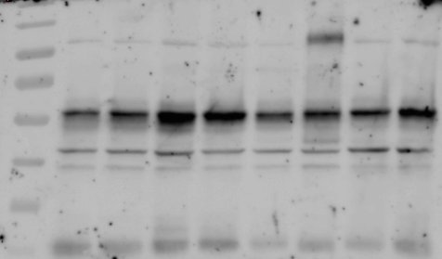
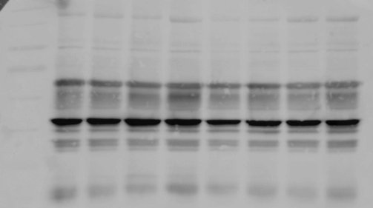
Uncropped blots for Figure 7C
180
130
100
70
55
ATG12
40
35
180
130
100
70
55
Actin
40

